Slide 1
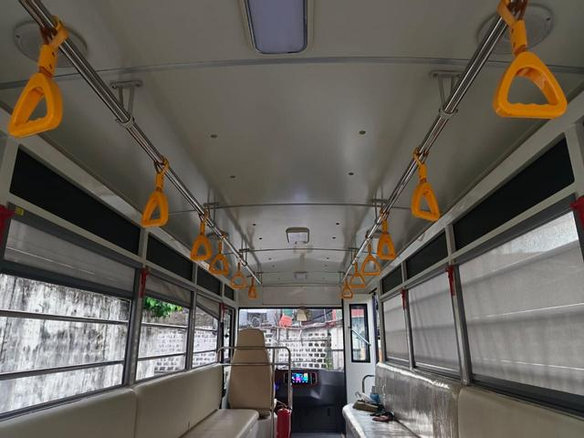
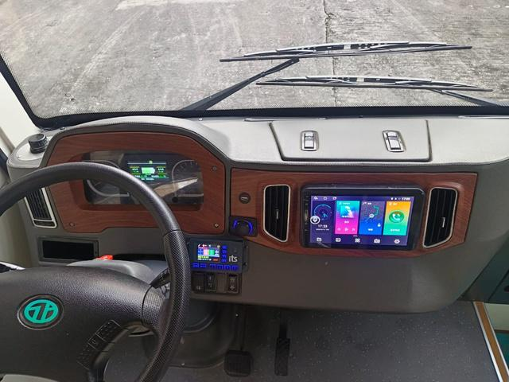
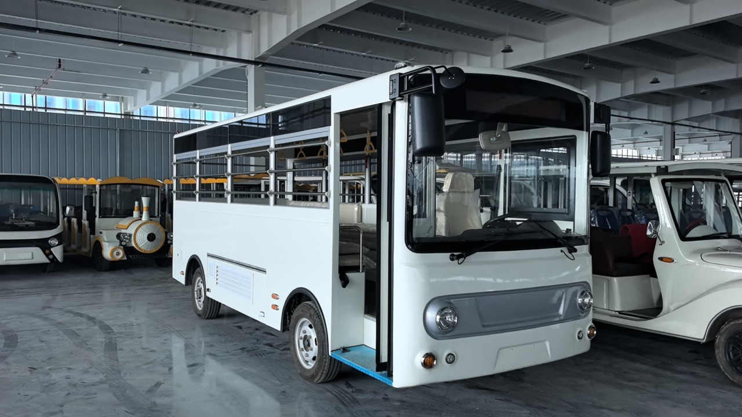
Main Specifications |  | JEX-E101
Vehicle Parameters | Overall Dimensions (mm) | 6,016 x 1,908 x 2,512
 | Wheelbase (mm) | 3,099
 | Front/Rear Overhang (mm) | 1,574 / 1,164
 | Gross Vehicle Weight (kg) | 4,317
 | Curb Weight (kg) | 2,592
 | Seating Capacity | 22+1 Driver
 | Max Speed (km/h) | 35 km/h
 | Driving Range (km) | 150 km
 | Max Climb slope | 10%
Power Battery | Manufacturer | CALB
 | Capacity (kWh) | 52 kWh
 | Cooling Method | Natural Cooling
 | System | Built in with remote monitoring control
Motor | Propulsion method | Pure Electric (RWD)
 | Motor Type | AC Asynchronous motor
 | Integration Setup | Integrated rear drive
 | Cooling Method | Natural cooling
 | Rated power (Kw) | 15 kW (20 hp)
Steering System | Steering Gear Type | Electric Power Steering
Suspension System | Leaf Springs | 8 leaves (Front and Rear)
Brake System | Regenerative | Front & Rear Drum Brakes
E-101
Specifications

